Slide 1
File-System Implementation
File-System Structure
Allocation Methods
Free-Space Management
Directory Implementation
Efficiency and Performance
Recovery
Operating System Concepts

Slide 2
File-System Structure
File structure
  Logical storage unit
  Collection of related information
File system resides on secondary storage (disks).
File system organized into layers.
File control block – storage structure consisting of information about a file.
Operating System Concepts

Slide 3
File Structure
None - sequence of words, bytes
Simple record structure
  Lines
  Fixed length
  Variable length
Complex Structures
  Formatted document
  Relocatable load file
Can simulate last two with first method by inserting appropriate control characters.
Who decides:
  Operating system
  Program
Operating System Concepts

Slide 4
File Concept
Contiguous logical address space
Types:
  Data
    numeric
    character
    binary
  Program
Operating System Concepts

Slide 5
File Attributes
Name – only information kept in human-readable form.
Type – needed for systems that support different types.
Location – pointer to file location on device.
Size – current file size.
Protection – controls who can do reading, writing, executing.
Time, date, and user identification – data for protection, security, and usage monitoring.
Information about files are kept in the directory structure, which is maintained on the disk.
Operating System Concepts

Slide 6
File Operations
create
write
read
reposition within file – file seek
delete
truncate
open(F_{i}) – search the directory structure on disk for entry F_{i}, and move the content of entry to memory.
close (F_{i}) – move the content of entry F_{i} in memory to directory structure on disk.
Operating System Concepts

Slide 7
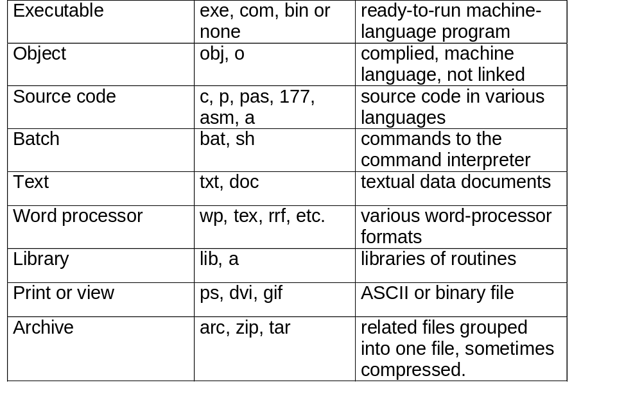
File Types – name, extension
Operating System Concepts

Slide 8
Access Methods
Sequential Access
read next
write next
reset
no read after last write
(rewrite)
Direct Access
read n
write n
position to n
read next
write next
rewrite n
n = relative block number
Operating System Concepts

Slide 9
Contiguous Allocation
Each file occupies a set of contiguous blocks on the disk.
Simple – only starting location (block #) and length (number of blocks) are required.
Random access.
Wasteful of space (dynamic storage-allocation problem).
Files cannot grow.
Mapping from logical to physical.
Q
LA/512
R
  Block to be accessed = ! + starting address
  Displacement into block = R
Operating System Concepts

Slide 10
Linked Allocation
Each file is a linked list of disk blocks: blocks may be scattered anywhere on the disk.
block =
pointer
Operating System Concepts

Slide 11

Allocate as needed, link together; e.g., file starts at block 9
Operating System Concepts

Slide 12
Linked Allocation (Cont.)
Simple – need only starting address
Free-space management system – no waste of space
No random access
Mapping
Q
LA/511
R
  Block to be accessed is the Qth block in the linked chain of blocks representing the file.
  Displacement into block = R + 1
File-allocation table (FAT) – disk-space allocation used by MS-DOS and OS/2.
Operating System Concepts

Slide 13
Indexed Allocation
Brings all pointers together into the index block.
Logical view.
index table
Operating System Concepts

Slide 14

Example of Indexed Allocation
Operating System Concepts

Slide 15
Indexed Allocation (Cont.)
Need index table
Random access
Dynamic access without external fragmentation, but have overhead of index block.
Mapping from logical to physical in a file of maximum size of 256K words and block size of 512 words. We need only 1 block for index table.
Q
LA/512
R
  Q = displacement into index table
  R = displacement into block
Operating System Concepts

Slide 16
Indexed Allocation – Mapping (Cont.)
Mapping from logical to physical in a file of unbounded length (block size of 512 words).
Linked scheme – Link blocks of index table (no limit on size).
Q₁
LA / (512 x 511)
R₁
  Q₁ = block of index table
  R₁ is used as follows:
Q₂
R₁ / 512
R₂
  Q₂ = displacement into block of index table
  R₂ displacement into block of file:
Operating System Concepts

Slide 17
Indexed Allocation – Mapping (Cont.)
Two-level index (maximum file size is 512³)
Q₁
LA / (512 x 512)
R₁
  Q₁ = displacement into outer-index
  R₁ is used as follows:
Q₂
R₁ / 512
R₂
  Q₂ = displacement into block of index table
  R₂ displacement into block of file:
Operating System Concepts

Slide 18
Indexed Allocation – Mapping (Cont.)

outer-index
index table
file
Operating System Concepts

Slide 19
Directory Structure
A collection of nodes containing information about all files.
Directory
Files
F 1
F 2
F 3
F 4
F n
Both the directory structure and the files reside on disk.
Backups of these two structures are kept on tapes.
Operating System Concepts

Slide 20
Information in a Device Directory
Name
Type
Address
Current length
Maximum length
Date last accessed (for archival)
Date last updated (for dump)
Owner ID (who pays)
Protection information (discuss later)
Operating System Concepts

Slide 21
Operations Performed on Directory
Search for a file
Create a file
Delete a file
List a directory
Rename a file
Traverse the file system
Operating System Concepts

Slide 22
Organize the Directory (Logically) to Obtain
Efficiency – locating a file quickly.
Naming – convenient to users.
  Two users can have same name for different files.
  The same file can have several different names.
Grouping – logical grouping of files by properties, (e.g., all Pascal programs, all games, …)
Operating System Concepts

